Slide 1
iPhemap Bugs
1. Link to “Group” on About Page is broken
2. Frontotemporal dementia is uncapitalized and not in alphabetical order.
3. Frontotemporal dementia/ALS is combined, which is our own doing based on how the paper reported it, should we separate? (see next page for 2,3)
4. Unnecessary period in GSE28366 under Studies
5. Methods summary isn’t the same as paper, should we change?
6. Multiple FAQ Answers include answers direct users to Research Tab, but the link is to the wrong page
i.e. It should take you to the methods section to answer one of the FAQ Questions
Q: “Where can I find more information about iPhemap and its creation?”
A: “All methods and detail descriptions of iPhemap’s creation can be accessed through the research tab.“

Slide 2
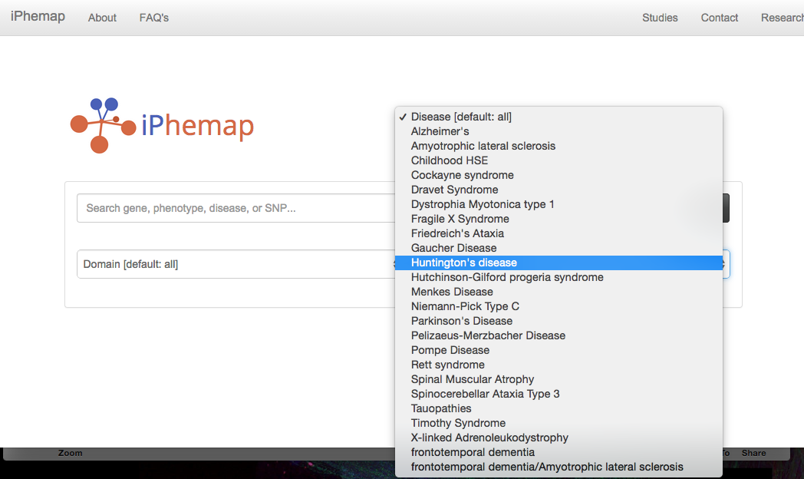

Slide 3
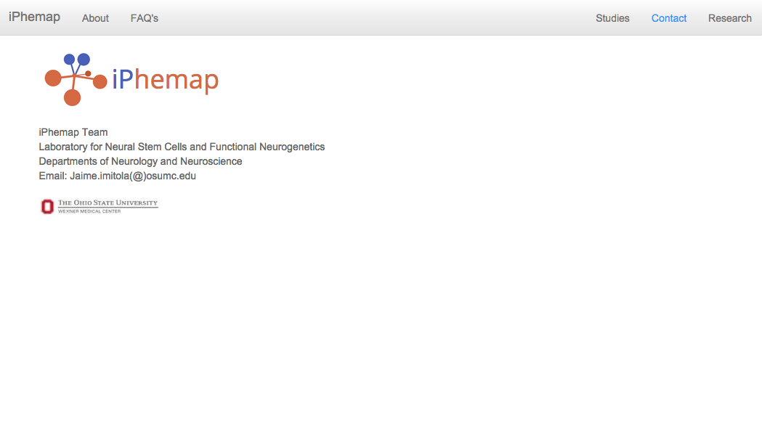

Suggestions
Footer bar with OSU wexner logo that is linked to medical center website, copyright, and date of last update
The Ohio State University
Last Update: August 8, 2015
WEXNER MEDICAL CENTER
©2015 The Ohio State University.

Slide 4

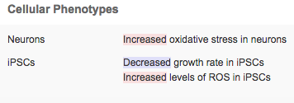
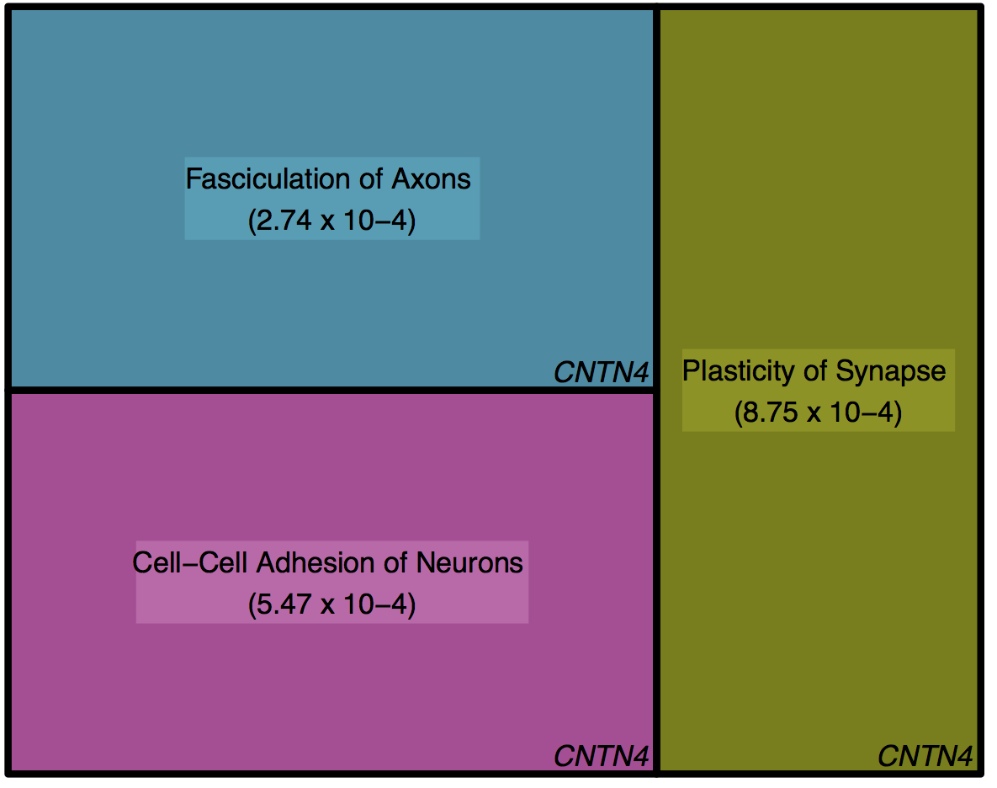
Suggestion: Addition of Update or News box, and data submission box for
Curation (see next page for more)
iPhemap is comprehensive regularly updated database that aims to provide a field synopsis and catalog all of the in vitro neuronal disease phenotypes from induced pluripotent stem cells (iPSCs) derived from patients with neurological diseases.
You can search cellular and molecular phenotypes from data from 74 published reports. We characterized 517 distinct cellular phenotypes and the resulting relationships between gene and phenotype into phenogenetic map that can be used to build new hypotheses in the field of neurological disease modeling, and to identify potential new opportunities to design novel drug strategies.
For details on the background and system biology methods used in iPhemap, see the Methods section. The website is developed and maintained by the Imitola Stem Cell Group.
iPhemap
100
Input
Output
iPhemap
Phenotypic and Genetic Expression Profiles
Searchable Database
Cellular
Phenotypes
Molecular
Phenotypes
Dysregulated
Pathways
iPhemap comprises a comprehensive catalog of phenogenetic profiles from
patient derived-iPSCs from highly curated, published reports and returns:
Cellular phenotypes reporting morphological, functional, and process changes from iPSCs, NSCs, oligodendrocytes, astrocytes, and neurons with genetic mutations linked to neurological diseases.
Molecular phenotypes, which stem from the microarray analysis, are derived from the functional annotations associated with previously established genome ontology. These molecular phenotypes are presented as treemaps, sized according to their degree of statistical significance.
Dysregulated pathways also arising from genome ontology, which reflect disrupted canonical pathways.
Announcements
Data Submission
Jun 14, 2016: Addition of 2 articles, 15 cellular phenotypes
Apr 22, 2016: Release of 12 datasets, including 4 molecular phenotypes
Mar 8, 2016:
Check the Following Inclusion Criteria
Employment of Neurologically Diseased Patient-Derived iPSCs?
Gene Mutation and SNP explicitly stated?

Slide 5
Suggestion: Have a data submission box for curation to better encourage iPhemap expansion
Something along the lines of this on the home page
Data Submission
Check the following inclusion criteria
Employment of neurologically diseased patient-derived iPSCs?
Comparison of mutated iPSCs versus control iPSCs?
Observation of phenotypic differences between cell lines?
Complete the following information:
PubMed ID:
Disease(s) Studied:
Gene Mutation(s):
Contact Email:
Submit

